Slide 1

DEPARTMENT OF COMPUTER SCIENCE AND ENGINEERING PROJECT PHASE III – MODEL REVIEW
Agile Cloud Encryption Framework
PROJECT STUDENTS GUIDE
Ch.Eswar, 41110270 Ms.E.Vinothini, M.E.,
P.Jaya Prakash, 41110943 Assistant Professor ,CSE

Slide 2
AGENDA
Abstract
Objective(s)
Literature Survey
Inferences from Literature Survey
Proposed System
Conclusion
References

Slide 3
ABSTRACT
The safe storage and transfer of data is ensured by the use of hashing algorithms and cloud infrastructure in the design of an encrypted file chunking system . This system aim is to create an secured web application. The use of cloud infrastructure provides scalability, ease of access, and cost effectiveness, making it an ideal choice for storing large volumes of data securely. Hashing algorithms play a crucial role in this system by generating unique hash values for each file chunk, which are used for integrity verification .These algorithms ensure that the data remains intact during storage and transmission by detecting any unauthorized modifications

Slide 4
OBJECTIVE(S)
to design, develop, and implement a comprehensive file encryption and chunking system within a cloud computing infrastructure.
This system aims to significantly enhance data security and
management in cloud environments.
The primary goals include the creation of robust encryption mechanisms to protect data at rest and in transit, the development of efficient data chunking techniques to optimize storage and retrieval processes.
By achieving these objectives, this research seeks to contribute to the mitigation of data security risks, improve data availability and integrity, and provide organizations with a tailored solution for enhanced data security and management within the realm of cloud computing.

Slide 5
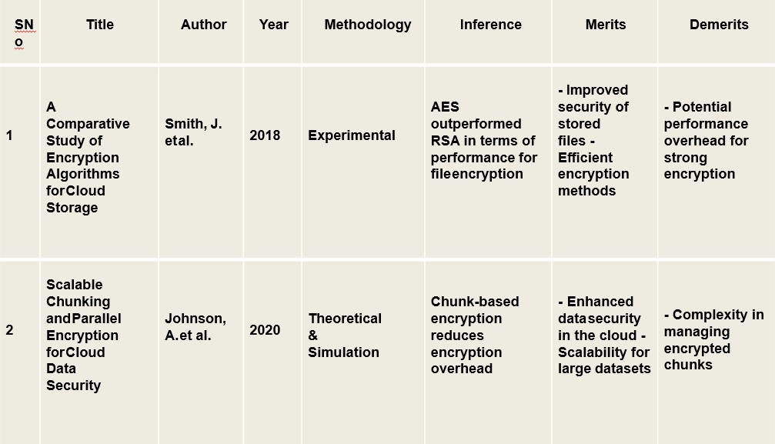
LITERATURE SURVEY

Slide 6
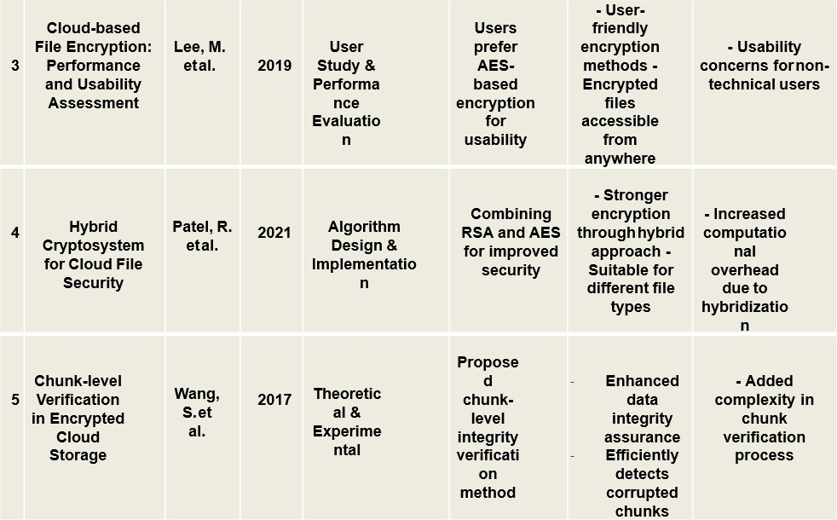
LITERATURE SURVEY
s

Slide 7
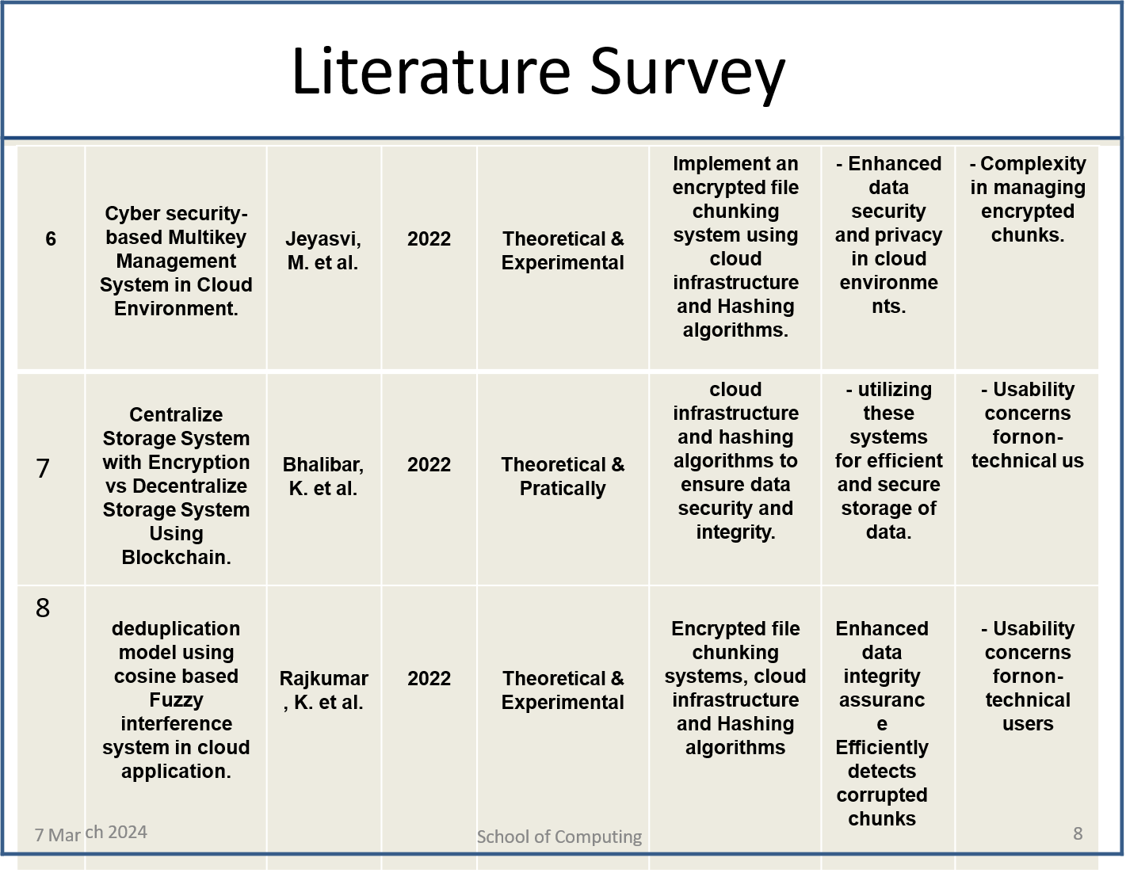
LITERATURE SURVEY
s

Slide 8
LITERATURE SURVEY
s

Slide 9
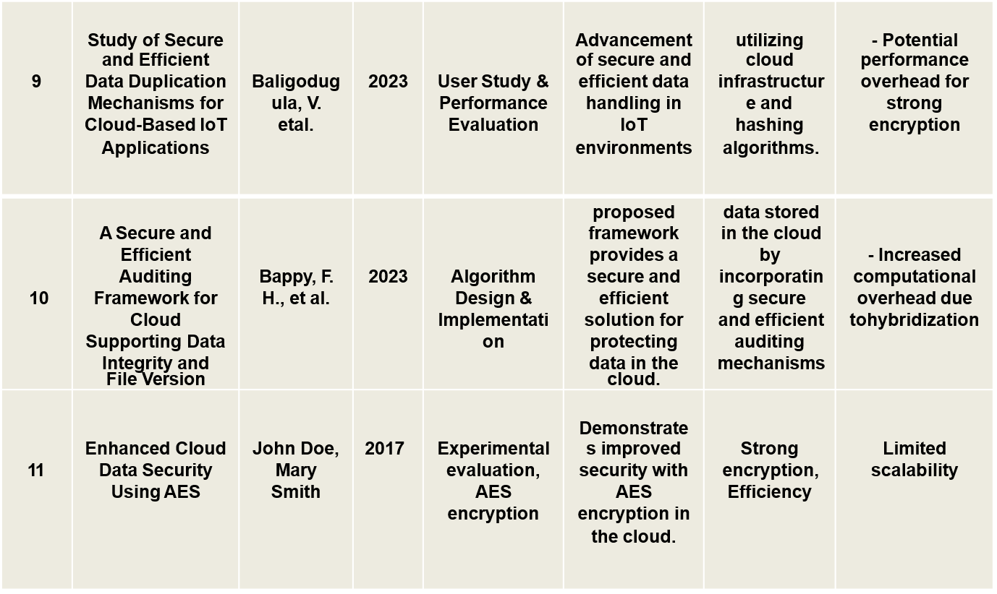
LITERATURE SURVEY
Control

Slide 10
INFERENCES FROM LITERATURE SURVEY
Data Security Concerns in Cloud Computing: The literature highlights a growing concern regarding data security within cloud computing environments.
As organizations increasingly rely on cloud services to store and manage their data, the risk of data breaches and unauthorized access has escalated.
Various encryption techniques and methods for securing data at rest and in transit have been explored, emphasizing the urgency of developing robust encryption systems.
Importance of Data Chunking: The survey underscores the significance of data chunking as an essential component of efficient data management in the cloud.

Slide 11
PROPOSED SYSTEM
Here, we report on a new method that combines multi-layer encryption, distributed file chunking, storage over several cloud platforms, and one-time password (OTP) based authentication to improve the security of cloud storage systems.
Our suggested method seeks to address a number of security issues, such as illegal access, data breaches, and data loss, that are related to file storage and retrieval in cloud environments.
Steps Involved In Proposed System:-
1.OTP Based Authentication
2.Multi-Layer Encryption 3.Distributed Storage
4.File Chunking

Slide 12
PROPOSED SYSTEM
Multiple cloud systems distribute encrypted file portions, reducing the risk of data loss or unwanted access that comes with single-point storage solutions.
Our approach improves resilience against possible assaults and guarantees data availability even in the event of cloud service failures or disruptions by distributing data infrastructures.
Here uploaded file will be stored in 3 different clouds(Distributed Storage).

Slide 13
PROPOSED SYSTEM
In order to optimize storage economy and strengthen security even more, the encrypted file is divided into smaller, fixed-size segments.
Chunking reduces the effect of individual cloud failures or breaches while enabling dispersed storage across various cloud platforms
A separate encryption technique is used to separately encrypt each chunk, which increases the storage process's complexity and security.

Slide 14
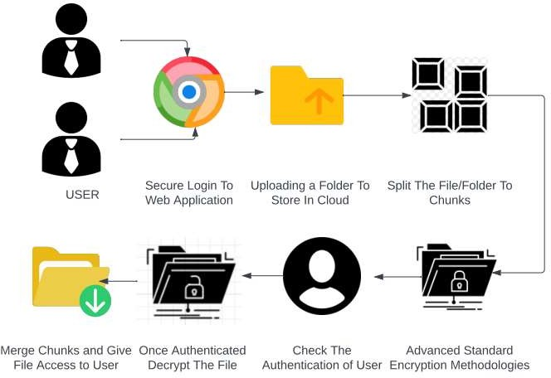
PROPOSED SYSTEM
System Architecture

Slide 15
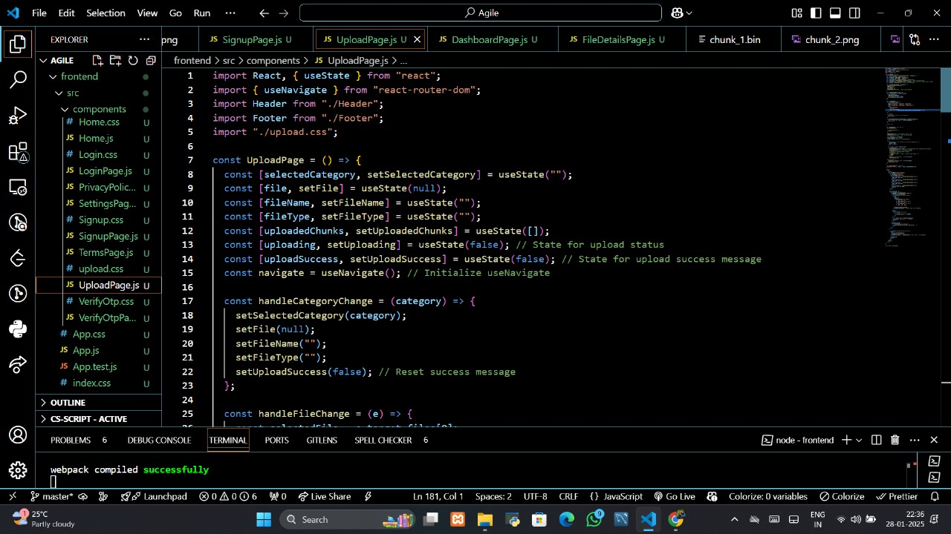
Results and Discussion

Slide 16
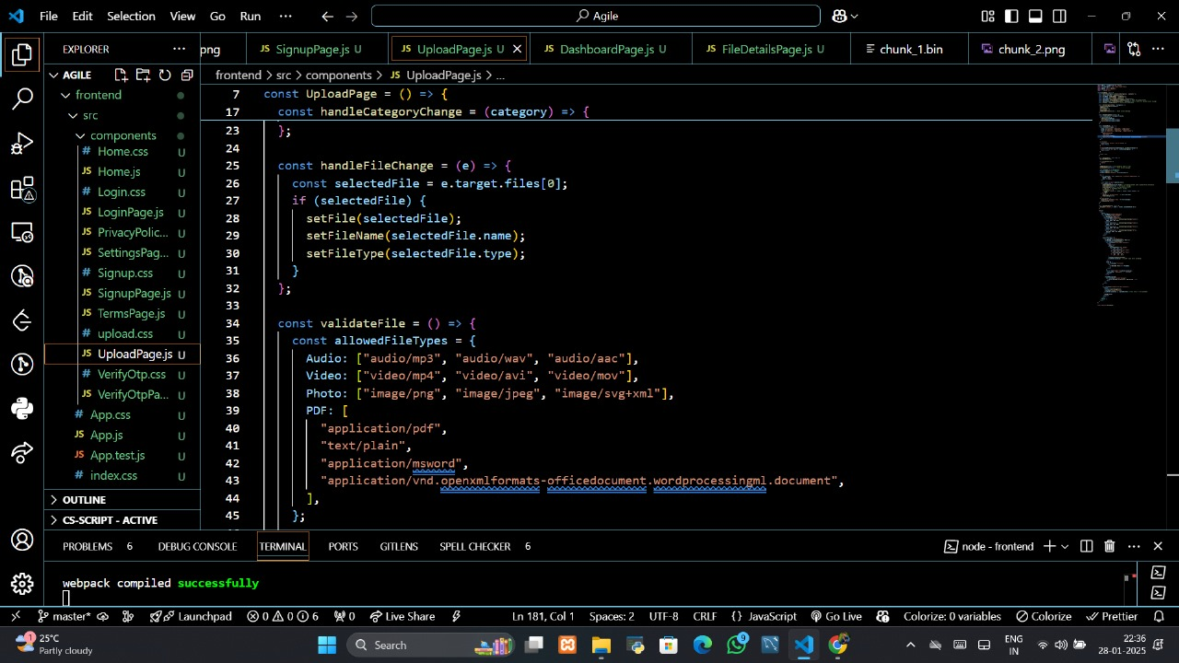
Results and Discussion

Slide 17
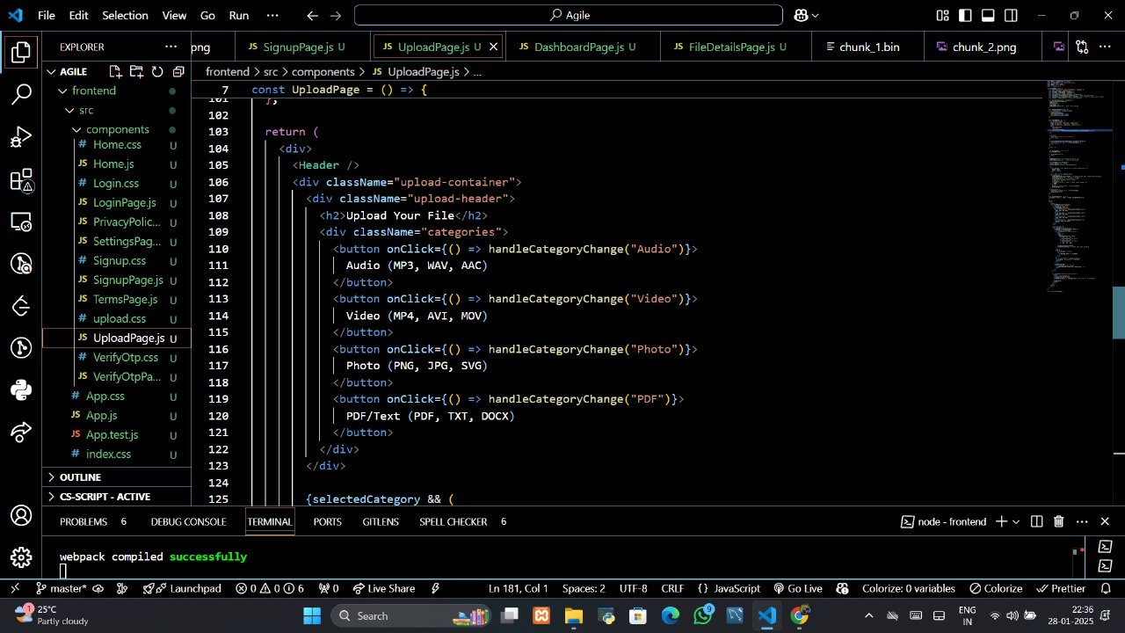
Results and Discussion

Slide 18
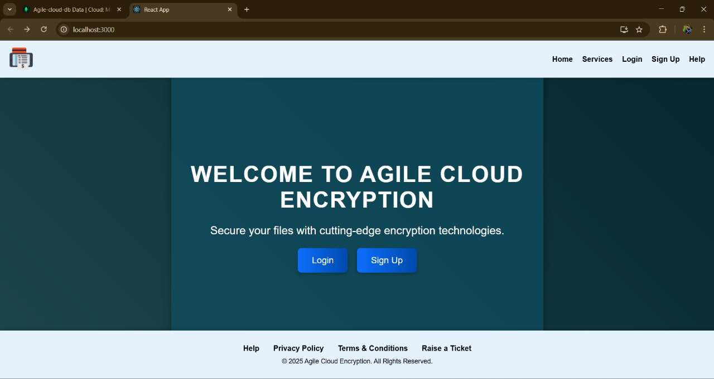
Results and Discussion

Slide 19
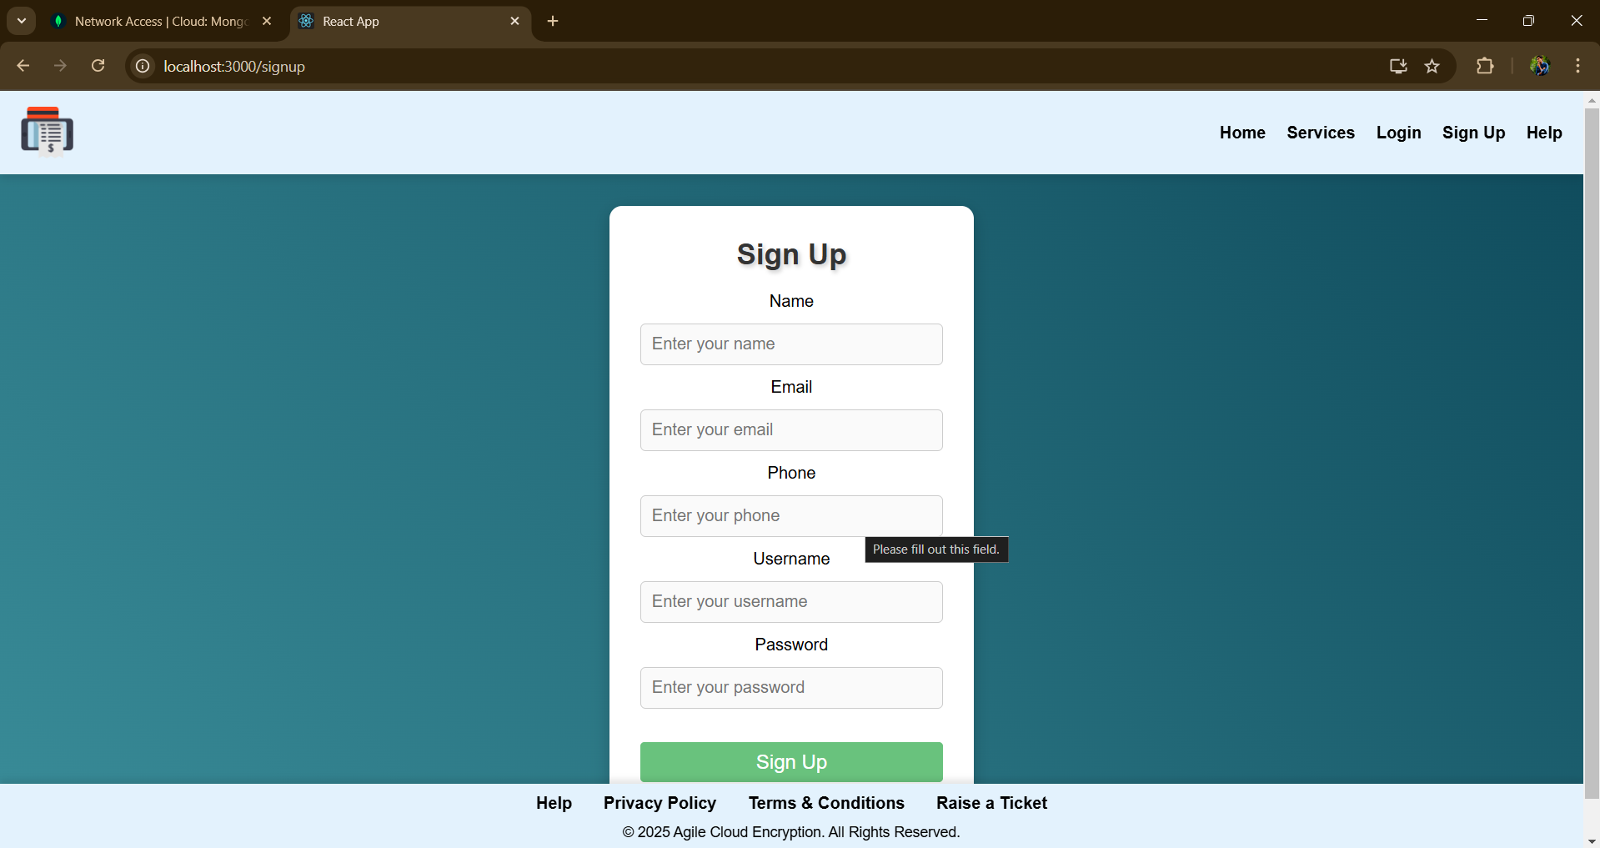
Results and Discussion

Slide 20
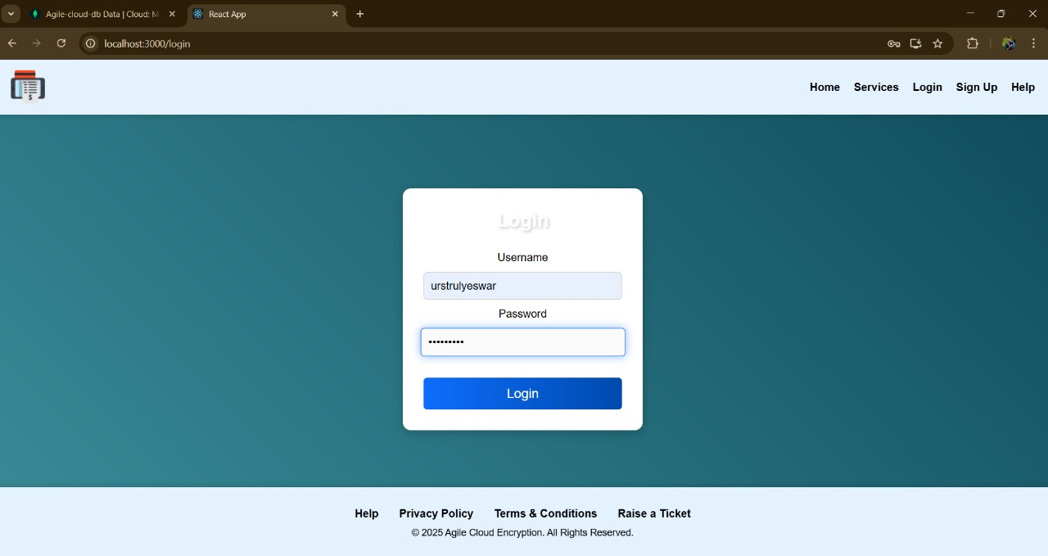
Results and Discussion

Slide 21
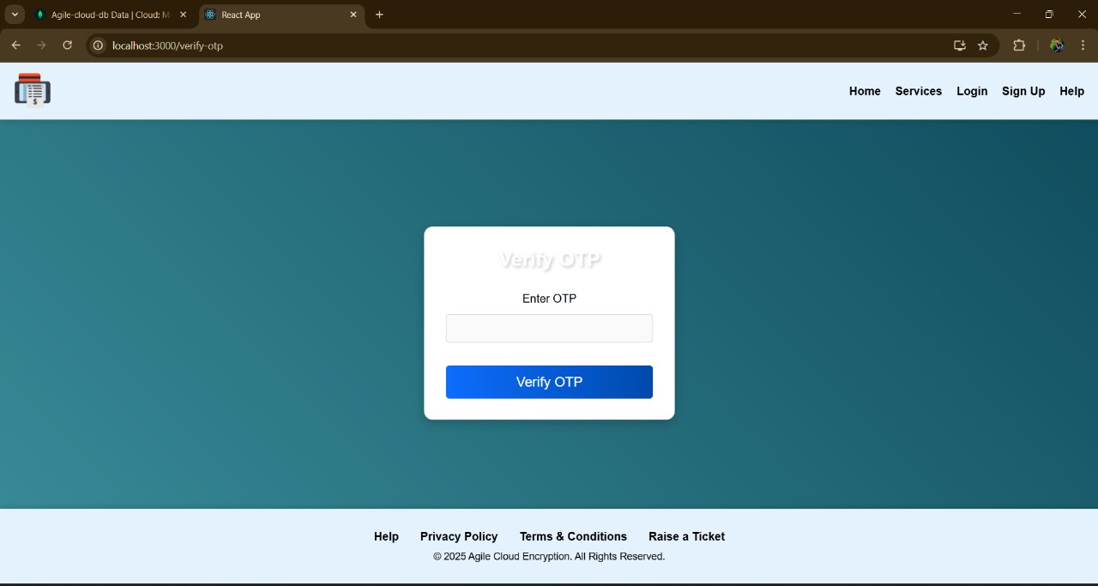
Results and Discussion

Slide 22
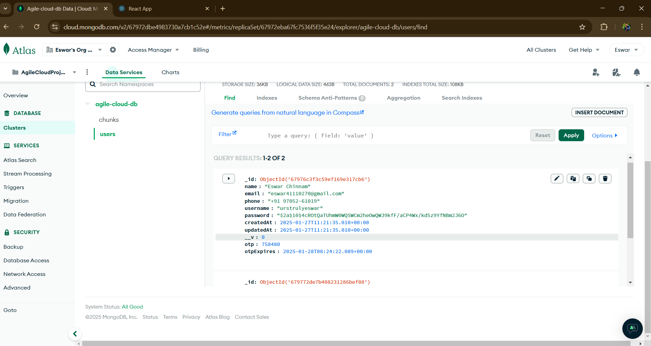
Results and Discussion

Slide 23
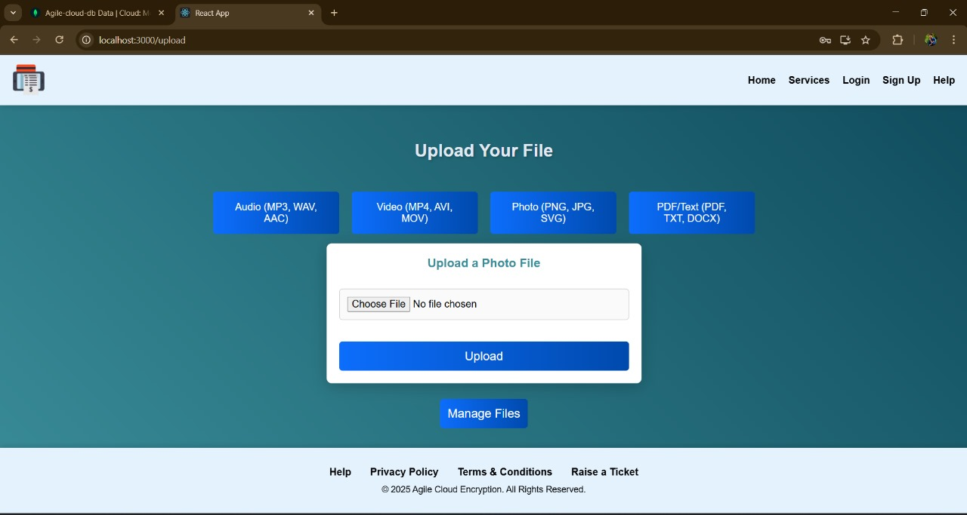
Results and Discussion

Slide 24
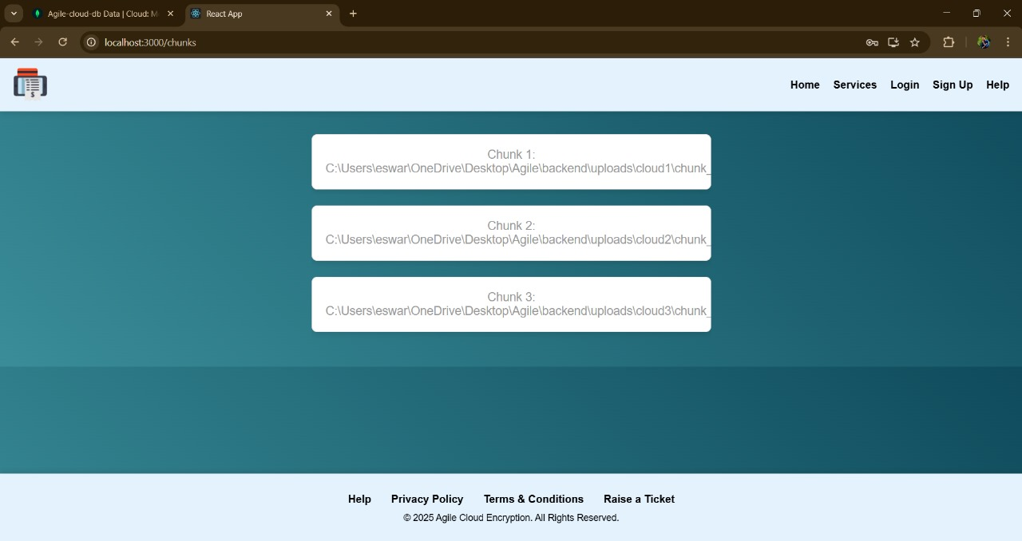
Results and Discussion

Slide 25
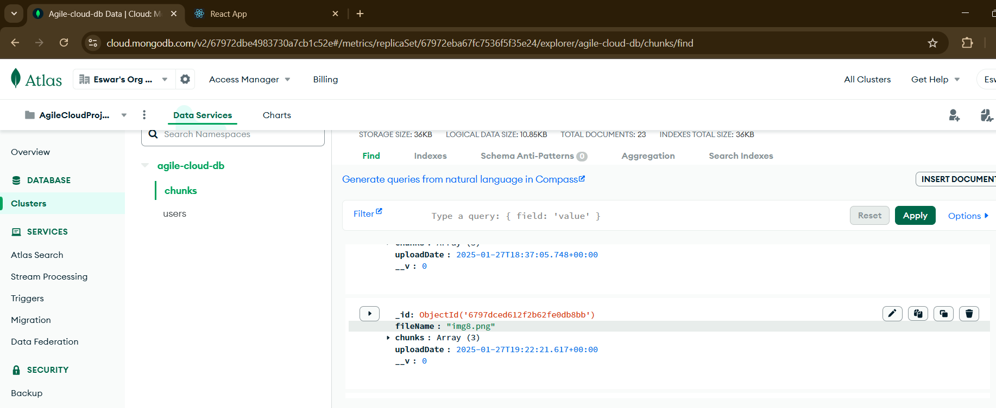
Results and Discussion

Slide 26
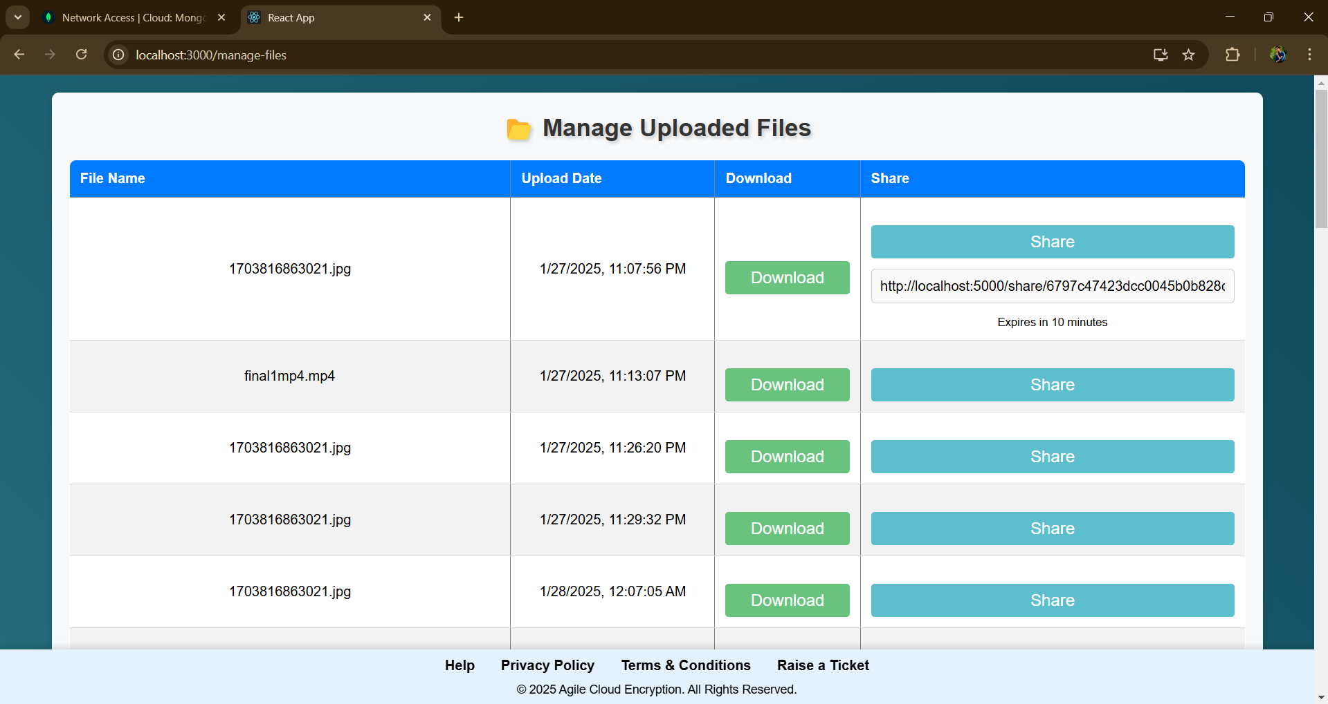
Results and Discussion

Slide 27
CONCLUSION
Incorporating robust encryption and intelligent chunking into a cloud- based file management system greatly enhances data security and storage efficiency.
vulnerabilities present in the existing systems.
This ensures data confidentiality and reduces storage overhead.
Its further implementation showcases its potential to be an essential component for secure and optimized cloud-based file handling.

Slide 28
REFERENCES
L. Hubert and R.Sirdey, "Authentication and Secured Executions for the Infrastructures as a the Service Layer of the Cloud Computing Model," 2013International Conference .
D. J. Ahn and J. Jeong, 2019 "A Bigdata Search Engine Based Cloud Computing Network." International Conference .
C. Xiao et al., "NV-eCryptfs: Accelerating Enterprise-Level Cryptographic File System with Non-Volatile Memory," Journals & Magazines.
M. -C. Yen, S. -Y. Chang and L. -P. Chang, "Lightweight, Integrated Data Deduplication for Write Stress Reduction of Mobile Flash Storage," Journals & Magazines.
O. K. Jasim Mohammad, S. Abbas, E. - S. M. El-Horbaty and A. -B. M. Salem, 2019 , "A comparative study between modern encryption algorithms based on cloud computing environment", International Conference.

Slide 29
REFERENCES
M. -C. Yen, S. -Y. Chang and L. -P. Chang, "Lightweight, Integrated Data Deduplication for Write Stress Reduction of Mobile Flash Storage," Journals & Magazines .
K. Yang and X. Jia, "An Efficient and Secure Dynamic Auditing Protocol for Data Storage in Cloud Computing", Journals & Magazines.
L. Zhou, V. Varadharajan and M. Hitchens, "Achieving Secure Role-Based Access Control on Encrypted Data in Cloud Storage" 2013, Journals &Magazines.
O. K. Jasim Mohammad, S. Abbas, E. - S. M. El-Horbaty and A. -B. M. Salem, 2019 , "A comparative study between modern encryption algorithms based on cloud computing environment", International Conference.

Slide 30
THANK YOU
We thank God, Our Department, Guide, Panel Members, Supportive Professors and all Technical and non Technical staff who helped us in our Project.

